Slide 1

IXIS Data Science Challenge
Alexander Friedrichsen

Slide 2
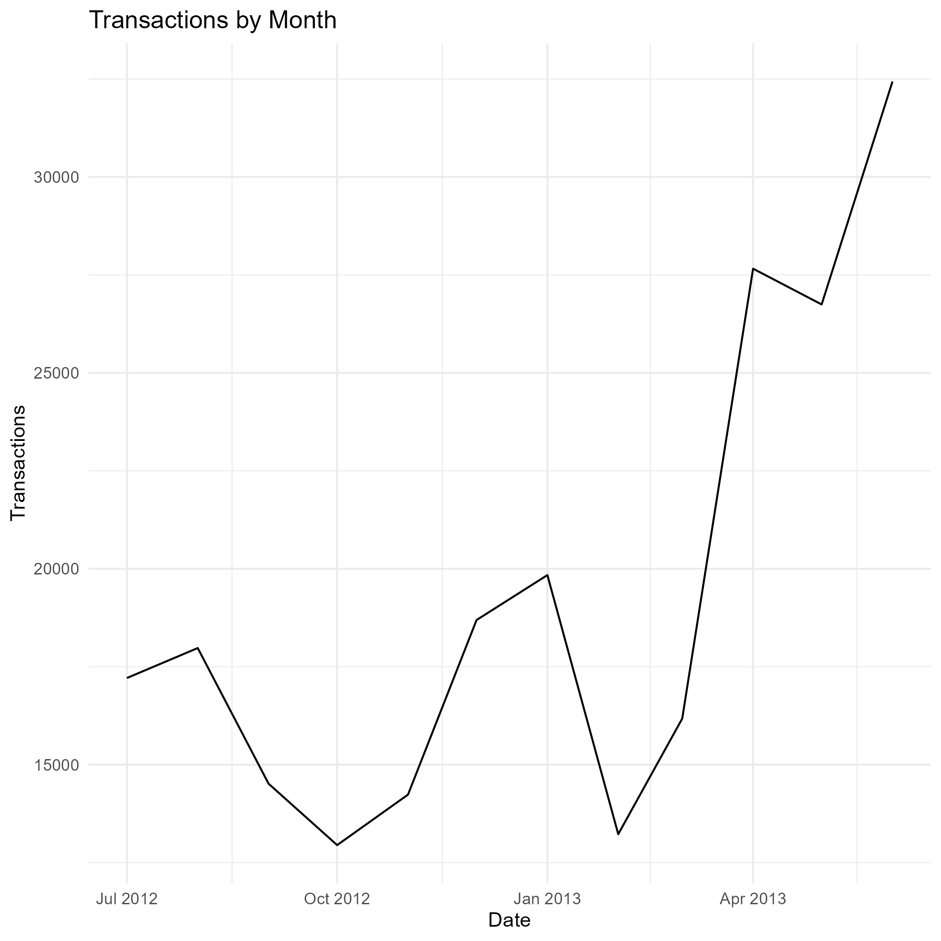
Traffic, QTY Transactions: All Increasing
Analyzed retail site Google analytics data from the past year, July 2012 to June 2013.
Data show a positive yearly growth with valleys in October, February. Spikes in December, January, and spiking April – Present.

Slide 3
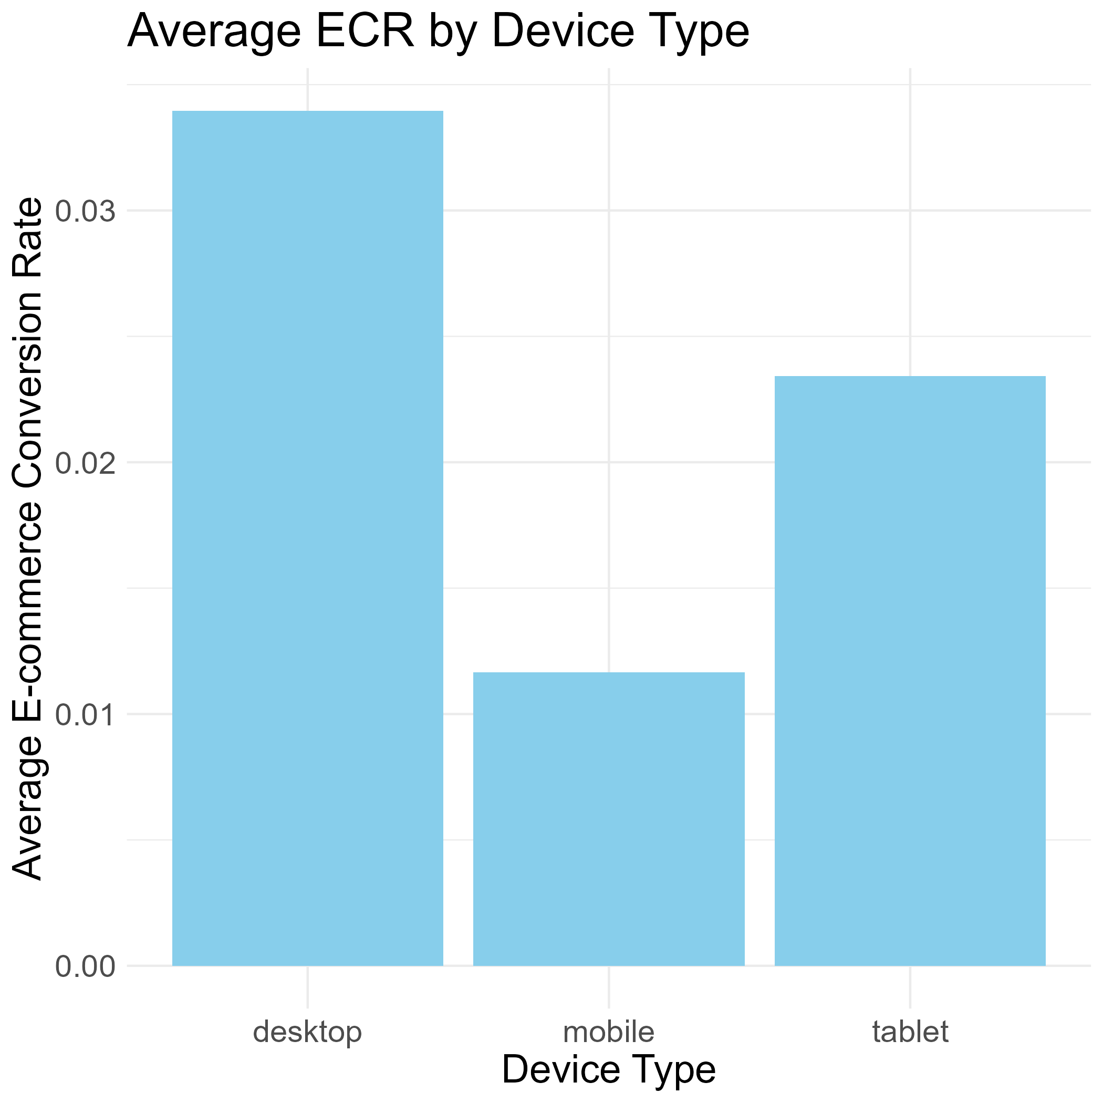
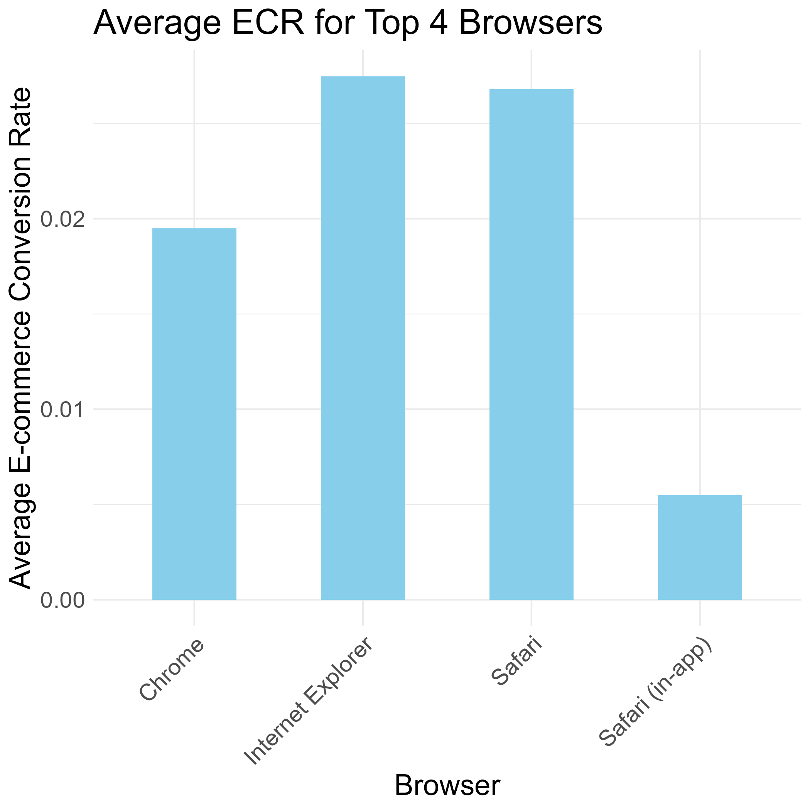
E-Commerce Conversion Rate

Slide 4
Two Month Snapshot
Sessions rose by 224195, transactions by 6124, and QTY by 10262.
AddsToCart fell by 21%. Buy it now feature?
year | month | Sessions | Transactions | QTY | ECR | addsToCart | Sessions_diff | Transactions_diff | QTY_diff | AddsToCart_diff
2013 | 6 | 1388834 | 34538 | 61891 | 0.02486834 | 107970 | 224195 | 6149 | 10262 | -28750
2013 | 5 | 1164639 | 28389 | 51629 | 0.02437579 | 136720 | -131974 | -1980 | -3317 | -47122
Sessions_diff_rel | Transactions_diff_rel | QTY_diff_rel | AddsToCart_diff_rel | year_month
0.19250171 | 0.21659798 | 0.19876426 | -0.2102838 | 2013-6
-0.1017836 | -0.0651981 | -0.0603684 | -0.2563179 | 2013-5

Slide 5
Next Steps
Conversion Rate Optimization (CRO):
Look at smoothing out mobile sale process
Identify why desktop users are more likely to buy
Set a goal for growth:
Continue monitoring key analytics, look for stagnation or decline
Collect more data:
Traffic source analysis, audience segmentation, user behavior analysis

Slide 6
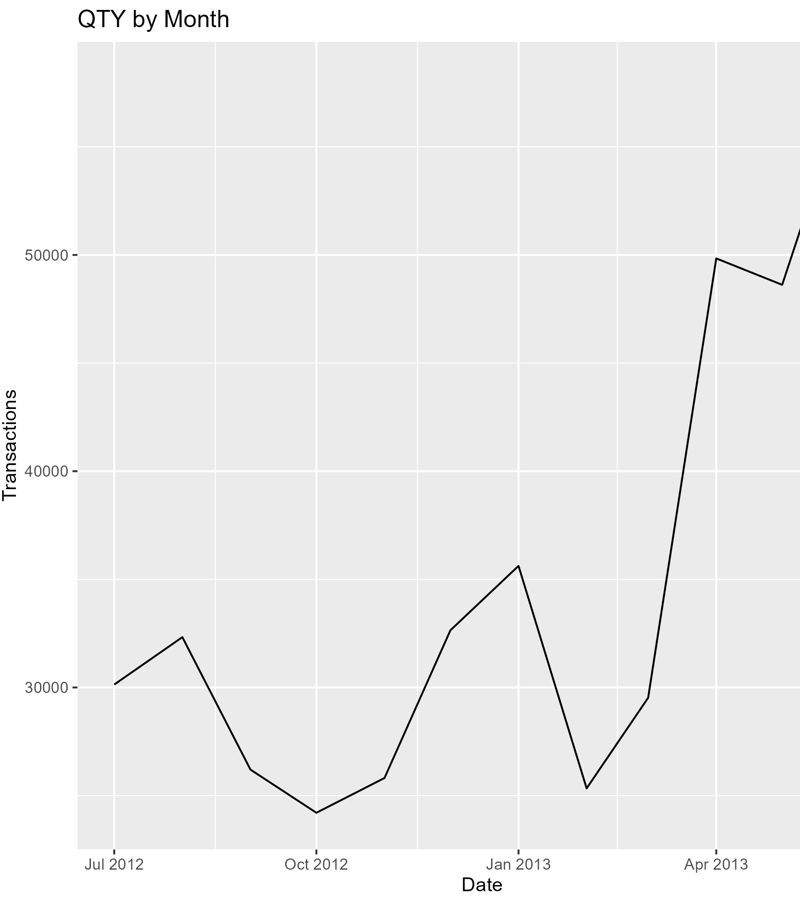
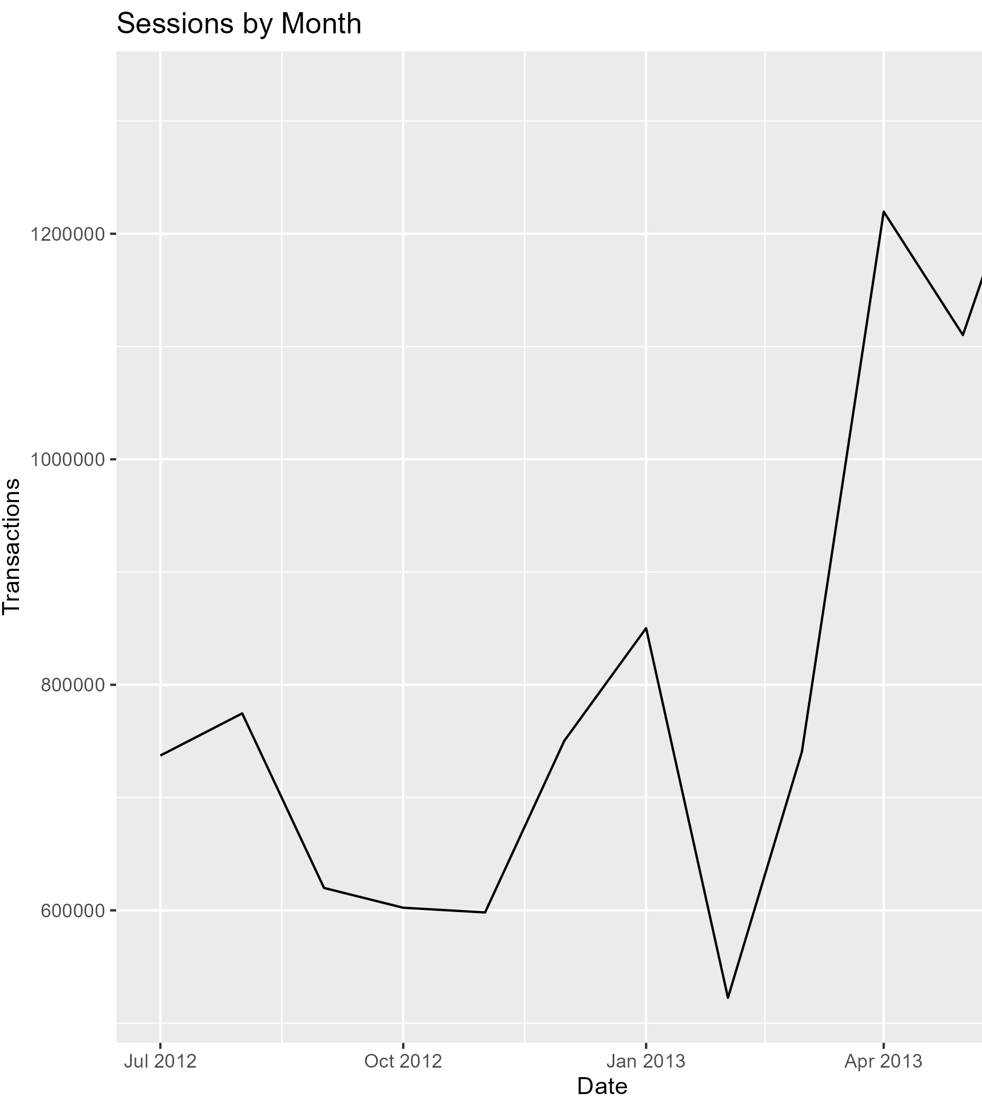
Appendix

Slide 7


About Me
Data Science Master’s @ UVM
Loves to optimize
Climber, Runner, Squash Player
Jazz Pianist
Lover of all types of games!
Pro MTG player

